Slide 1
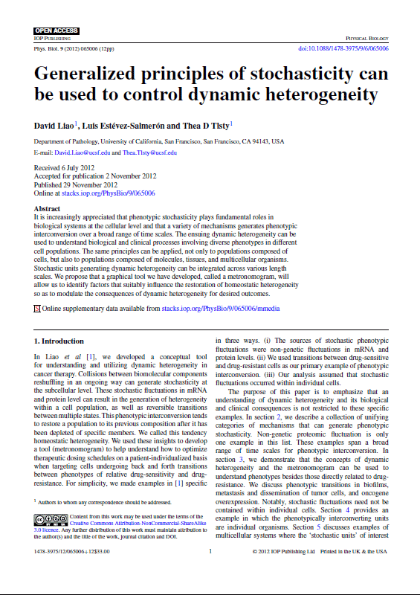
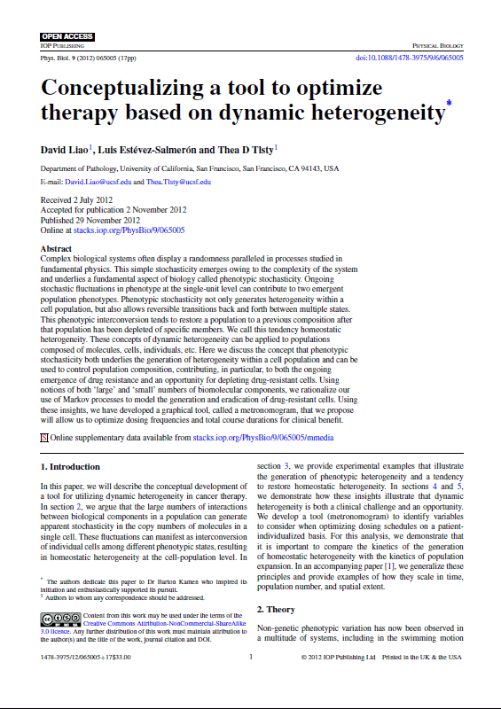
Dynamic heterogeneity
for the physical oncologist
Liao D, Estévez-Salmerón L and Tlsty TD 2012
Conceptualizing a tool to optimize therapy based on dynamic heterogeneity* Phys. Biol. 9(6) 065005
(doi:10.1088/1478-3975/9/6/065005)
Liao D, Estévez-Salmerón L and Tlsty TD 2012
Generalized principles of stochasticity can be used to control dynamic heterogeneity Phys. Biol. 9(6) 065006
(doi:10.1088/1478-3975/9/6/065006)
* The authors dedicate this paper to Dr Barton Kamen who inspired its initiation and enthusiastically supported its pursuit.
Notes:
Improve cancer therapy
Rationale for current MTD therapy
Benefits of metronomic therapy
Difficulty broadening adoption
Want to understand

Slide 2

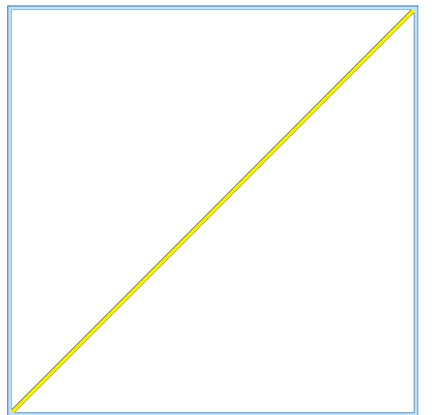



Dynamic heterogeneity
for the physical oncologist
Seeming randomness
Outcome vs. frequency
$$t$$
0
1
2
3
Interconversion
Ø
Ø
Notes:
Improve cancer therapy
Rationale for current MTD therapy
Benefits of metronomic therapy
Difficulty broadening adoption
Want to understand

Slide 3
Timings of biochemical reactions can seem to display randomness
Notes:
Reshuffling like a deck of cards
forgets how previously stacked

Slide 4



Timings of biochemical reactions can seem to display randomness
$$t$$
0
1
2
3
4
Notes:
Reshuffling like a deck of cards
forgets how previously stacked

Slide 5
Timings of biochemical reactions can seem to display randomness
$$t$$
0
1
2
3
4
Notes:
Reshuffling like a deck of cards
forgets how previously stacked

Slide 6

Timings of biochemical reactions can seem to display randomness
Messy variety of durations between events
Unpredictability: Varied outcomes
$$t$$
0
1
2
3
4
no protein
Notes:
Reshuffling like a deck of cards
forgets how previously stacked

Slide 7
Dynamic heterogeneity
for the physical oncologist
Seeming randomness
Outcome vs. frequency
$$t$$
0
1
2
3
Interconversion
Ø
Ø
Notes:
Improve cancer therapy
Rationale for current MTD therapy
Benefits of metronomic therapy
Difficulty broadening adoption
Want to understand

Slide 8


Phenotypes can be stochastic and interconvert
no
product
$$t$$
0
1
2
3
4
5
6
7
8
9
10
Relatively resistant
Protein in cell A
Relatively sensitive
Protein in cell B

Slide 9
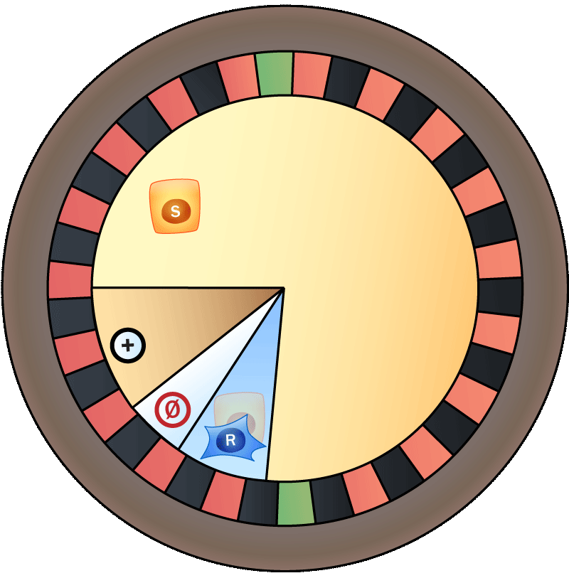
Use Markov models to approximate phenotypic transitions
t_{i}
t_{i} + Δt
Protein in cell
$$t$$
0
1
2
3
4
5
6
7
8
9
10

Slide 10

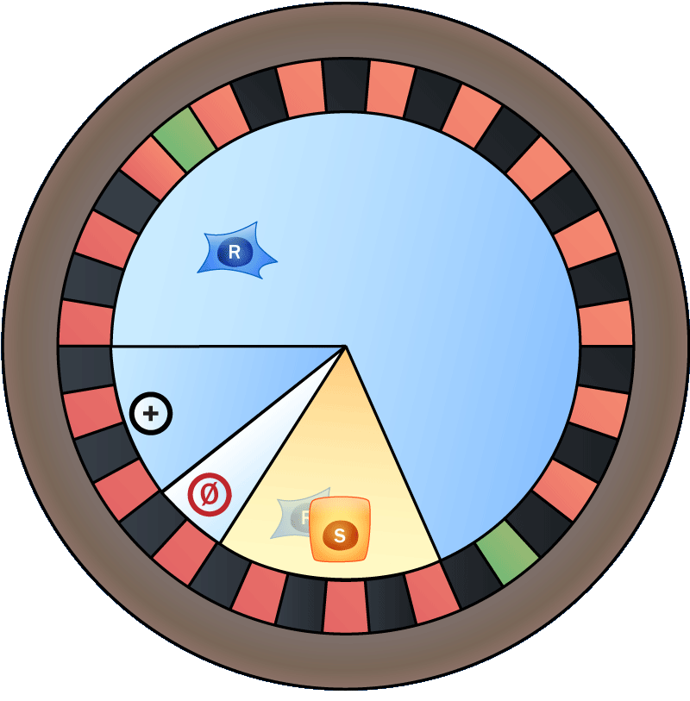



Use Markov models to approximate phenotypic transitions
t_{i}
m_{S}
r_{R}
Ø
c_{R}
c_{S}
m_{R}
Ø
r_{S}
f
t_{i} + Δt
Protein in cell
$$t$$
0
1
2
3
4
5
6
7
8
9
10
Notes:
Instantaneous drug kill

Slide 11
Dynamic heterogeneity
for the physical oncologist
Seeming randomness
Outcome vs. frequency
$$t$$
0
1
2
3
Interconversion
Ø
Ø
Notes:
Improve cancer therapy
Rationale for current MTD therapy
Benefits of metronomic therapy
Difficulty broadening adoption
Want to understand

Slide 12




Metronomogram
Given:
Ø
Ø
Cannot directly kill “R”
Illustrate: When can deplete S + R
Cell kill
Cell kill (t = 0)
N(0⁺)
Δt
N(Δt⁻)
Cell kill (t = Δt)
N(Δt⁺)
T_{CD}
Cell kill

Slide 13

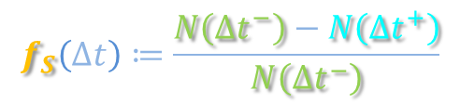
Metronomogram
Given:
Ø
Killed
$$f_{S}\left(∆t\right)≔\frac{N\left({∆t}^{−}\right)−N\left({∆t}^{+}\right)}{N\left({∆t}^{−}\right)}$$
Ø
Cannot directly kill “R”
Illustrate: When can deplete S + R
Cell kill
Cell kill (t = 0)
N(0⁺)
Δt
N(Δt⁻)
Cell kill (t = Δt)
N(Δt⁺)
T_{CD}
Cell kill

Slide 14

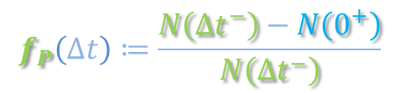
Metronomogram
Given:
Ø
Killed
$$f_{S}\left(∆t\right)≔\frac{N\left({∆t}^{−}\right)−N\left({∆t}^{+}\right)}{N\left({∆t}^{−}\right)}$$
Ø
Cannot directly kill “R”
Illustrate: When can deplete S + R
Cell kill
Cell kill (t = 0)
N(0⁺)
Δt
N(Δt⁻)
Cell kill (t = Δt)
N(Δt⁺)
T_{CD}
Expansion
$$f_{P}\left(∆t\right)≔\frac{N\left({∆t}^{−}\right)−N\left(0^{+}\right)}{N\left({∆t}^{−}\right)}$$
Cell kill

Slide 15
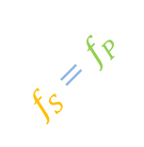


Metronomogram
Given:
Ø
Killed
$$f_{S}\left(∆t\right)≔\frac{N\left({∆t}^{−}\right)−N\left({∆t}^{+}\right)}{N\left({∆t}^{−}\right)}$$
Ø
1.0
Cannot directly kill “R”
$$f_{S}>f_{P}$$
Illustrate: When can deplete S + R
0.8
>
Cell kill
0.6
Sensitized fraction
0.4
$$f_{S}=f_{P}$$
Cell kill (t = 0)
N(0⁺)
Δt
0.2
N(Δt⁻)
$$f_{S}<f_{P}$$
Cell kill (t = Δt)
0
N(Δt⁺)
0.2
0.4
0.6
0.8
1.0
T_{CD}
Population expansion fraction
Expansion
$$f_{P}\left(∆t\right)≔\frac{N\left({∆t}^{−}\right)−N\left(0^{+}\right)}{N\left({∆t}^{−}\right)}$$
Cell kill

Slide 16
Metronomogram
Given:
Ø
$$f_{S}\left(∆t\right)≔\frac{N\left({∆t}^{−}\right)−N\left({∆t}^{+}\right)}{N\left({∆t}^{−}\right)}$$
Ø
1.0
Cannot directly kill “R”
$$f_{S}>f_{P}$$
Illustrate: When can deplete S + R
0.8
Cell kill
0.6
Sensitized fraction
0.4
$$f_{S}=f_{P}$$
Cell kill (t = 0)
N(0⁺)
Δt
0.2
N(Δt⁻)
$$f_{S}<f_{P}$$
Cell kill (t = Δt)
0
N(Δt⁺)
0.2
0.4
0.6
0.8
1.0
T_{CD}
Population expansion fraction
$$f_{P}\left(∆t\right)≔\frac{N\left({∆t}^{−}\right)−N\left(0^{+}\right)}{N\left({∆t}^{−}\right)}$$
Cell kill

Slide 17
Metronomogram
Given:
Ø
$$f_{S}\left(∆t\right)≔\frac{N\left({∆t}^{−}\right)−N\left({∆t}^{+}\right)}{N\left({∆t}^{−}\right)}$$
Ø
1.0
Cannot directly kill “R”
$$f_{S}>f_{P}$$
Illustrate: When can deplete S + R
0.8
S and R
R only
0.6
Sensitized fraction
S and R
0.4
$$f_{S}=f_{P}$$
R only
N(0⁺)
Δt
0.2
S and R
N(Δt⁻)
$$f_{S}<f_{P}$$
0
0.2
0.4
0.6
0.8
1.0
R only
N(Δt⁺)
Population expansion fraction
$$f_{P}\left(∆t\right)≔\frac{N\left({∆t}^{−}\right)−N\left(0^{+}\right)}{N\left({∆t}^{−}\right)}$$

Slide 18
Metronomogram
Given:
Ø
$$f_{S}\left(∆t\right)≔\frac{N\left({∆t}^{−}\right)−N\left({∆t}^{+}\right)}{N\left({∆t}^{−}\right)}$$
Ø
1.0
Cannot directly kill “R”
$$f_{S}>f_{P}$$
Illustrate: When can deplete S + R
0.8
S and R
R only
0.6
Sensitized fraction
S and R
0.4
$$f_{S}=f_{P}$$
R only
N(0⁺)
Δt
0.2
S and R
N(Δt⁻)
$$f_{S}<f_{P}$$
0
0.2
0.4
0.6
0.8
1.0
R only
N(Δt⁺)
Population expansion fraction
$$f_{P}\left(∆t\right)≔\frac{N\left({∆t}^{−}\right)−N\left(0^{+}\right)}{N\left({∆t}^{−}\right)}$$

Slide 19
Metronomogram
Given:
Ø
$$f_{S}\left(∆t\right)≔\frac{N\left({∆t}^{−}\right)−N\left({∆t}^{+}\right)}{N\left({∆t}^{−}\right)}$$
Ø
1.0
Cannot directly kill “R”
$$f_{S}>f_{P}$$
Illustrate: When can deplete S + R
0.8
Cell kill
0.6
Expansion and
interconversion
Sensitized fraction
0.4
$$f_{S}=f_{P}$$
Cell kill (t = 0)
N(0⁺)
Δt
0.2
N(Δt⁻)
$$f_{S}<f_{P}$$
Cell kill (t = Δt)
0
N(Δt⁺)
0.2
0.4
0.6
0.8
1.0
T_{CD}
Population expansion fraction
$$f_{P}\left(∆t\right)≔\frac{N\left({∆t}^{−}\right)−N\left(0^{+}\right)}{N\left({∆t}^{−}\right)}$$
Cell kill

Slide 20
Dynamic heterogeneity
for the physical oncologist
Seeming randomness
Outcome vs. frequency
$$t$$
0
1
2
3
Interconversion
Ø
Ø
Notes:
Improve cancer therapy
Rationale for current MTD therapy
Benefits of metronomic therapy
Difficulty broadening adoption
Want to understand

Slide 21
Dynamic heterogeneity
for the physical oncologist
Liao D, Estévez-Salmerón L and Tlsty TD 2012
Conceptualizing a tool to optimize therapy based on dynamic heterogeneity* Phys. Biol. 9(6) 065005
(doi:10.1088/1478-3975/9/6/065005)
Liao D, Estévez-Salmerón L and Tlsty TD 2012
Generalized principles of stochasticity can be used to control dynamic heterogeneity Phys. Biol. 9(6) 065006
(doi:10.1088/1478-3975/9/6/065006)
* The authors dedicate this paper to Dr Barton Kamen who inspired its initiation and enthusiastically supported its pursuit.
Notes:
Improve cancer therapy
Rationale for current MTD therapy
Benefits of metronomic therapy
Difficulty broadening adoption
Want to understand

